Slide 1
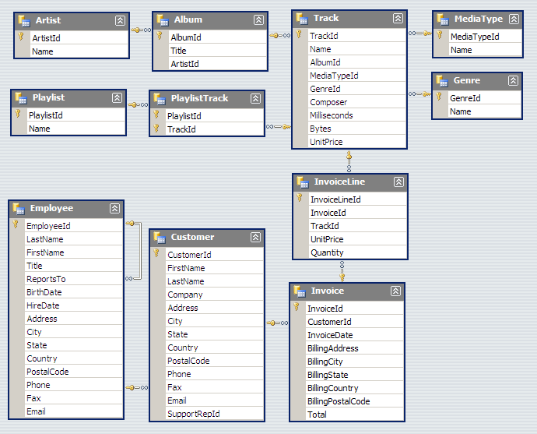
Chinook Database
Notes:
http://chinookdatabase.codeplex.com/wikipage?title=Chinook_Schema

Slide 2
Total Order Volume from each country
The table shows the TOP 5 highest order volume country of total invoice and money for each country spent on the album. Comparing to others country, the customer from the USA has spent more than 2 to 3 times larger than any country.
SQL Query
Please see slide notes
Notes:
SELECT
COUNT(Customer.Country) AS Purchase,
Customer.Country AS BillingCountry,
Total(Invoice.Total) AS TotalSales
FROM Invoice
INNER JOIN Customer
ON (BillingCountry IS NOT NULL AND Customer.CustomerId = Invoice.CustomerId)
GROUP BY Customer.Country
ORDER BY TotalSales DESC
LIMIT 5;

Slide 3
Comparison of Order Volume by Genre
The chart shows the comparison ratio of TOP 5 countries for all the Genre. The result shows USA is the only country that likes comedy track in this TOP 5 countries.
SQL Query
Please see slide notes
Notes:
SELECT
Genre.Name AS Genre,
SUM(CASE WHEN Invoice.BillingCountry = 'USA' THEN 1 ELSE 0 END) AS 'USA',
SUM(CASE WHEN Invoice.BillingCountry = 'Canada' THEN 1 ELSE 0 END) AS 'Canada',
SUM(CASE WHEN Invoice.BillingCountry = 'France' THEN 1 ELSE 0 END) AS 'France',
SUM(CASE WHEN Invoice.BillingCountry = 'Brazil' THEN 1 ELSE 0 END) AS 'Brazil',
SUM(CASE WHEN Invoice.BillingCountry = 'Germany' THEN 1 ELSE 0 END) AS 'Germany'
FROM InvoiceLine
INNER JOIN Track
ON InvoiceLine.TrackId = Track.TrackId
INNER JOIN MediaType
ON Track.MediaTypeId = MediaType.MediaTypeId
INNER JOIN Genre
ON Track.GenreId = Genre.GenreId
INNER JOIN Invoice
ON Invoice.InvoiceId = InvoiceLine.InvoiceId
INNER JOIN Customer
ON Invoice.CustomerId = Customer.CustomerId
GROUP BY Genre ORDER BY Genre;

Slide 4
Highest and Average Spent From A Country
In this chart, it shows the highest and average spent from a country of each customer. The average of this all countries are very similar and the highest spent of the country is the Czech Republic.
SQL Query
Please see slide notes
Notes:
SELECT
Customer.Country AS BillingCountry,
AVG(Invoice.Total) AS AverageSpent,
max(Invoice.Total) AS HighestSpent
FROM Invoice
INNER JOIN Customer
ON (BillingCountry IS NOT NULL AND Customer.CustomerId = Invoice.CustomerId)
GROUP BY BillingCountry
ORDER BY AverageSpent;

Slide 5
Comparison of Order Volume by Media Types
The chart shows the comparison ratio of TOP 5 countries for all the Media Types. The result shows that customer from this TOP 5 countries is only France has accepted the Purchased AAC audio file.
SQL Query
Please see slide notes
Notes:
SELECT
Invoice.BillingCountry AS Country,
SUM(CASE WHEN MediaType.MediaTypeId = '1' THEN 1 ELSE 0 END) AS 'MPEG audio file',
SUM(CASE WHEN MediaType.MediaTypeId = '2' THEN 1 ELSE 0 END) AS 'Protected AAC audio file',
SUM(CASE WHEN MediaType.MediaTypeId = '3' THEN 1 ELSE 0 END) AS 'Protected MPEG-4 video file',
SUM(CASE WHEN MediaType.MediaTypeId = '4' THEN 1 ELSE 0 END) AS 'Purchased AAC audio file',
SUM(CASE WHEN MediaType.MediaTypeId = '5' THEN 1 ELSE 0 END) AS 'AAC audio file',
COUNT(Country) AS 'Total'
FROM InvoiceLine
INNER JOIN Track
ON InvoiceLine.TrackId = Track.TrackId
INNER JOIN MediaType
ON Track.MediaTypeId = MediaType.MediaTypeId
INNER JOIN Genre
ON Track.GenreId = Genre.GenreId
INNER JOIN Invoice
ON Invoice.InvoiceId = InvoiceLine.InvoiceId
INNER JOIN Customer
ON Invoice.CustomerId = Customer.CustomerId
GROUP BY Country ORDER BY "Total" DESC
LIMIT 5;

